Slide 1
Data Access Framework
Entity Framework, NHibernate, ORMs
by Harry Chou

Slide 2
Layered App
Web/Windows
Service / Presentation
objects
Logic
data
DB

Slide 3
Data Access Framework History
Low Level Driver Library
ODBC, OLE DB, ADO, RDS, Jet Engine
ADO.NET
Various ADO.NET libraries (ORM)
NHibernate
Entity Framework
Micro-ORM

Slide 4
Data Access Framework
Persistence Framework
CRUD
Application does all the work in memory
based on some already stored data (Retrieve)
eventually, you need to store back changes (Create, Update, Delete)
It just happens Relational Database is the popular choice for most business

Slide 5
Logic/Object Layer
Display Stuff
Objects work together to perform tasks > Display info on screen
Create Stuff
New Objects, maybe based on some existing objects
Update Stuff
Existing objects, change relationship of objects, or change data elements of the object

Slide 6
DB/Relational Layer
Select
Insert
Update
Delete
Join

Slide 7
Mismatch
object id vs. keys
inheritance vs. ??
association between objects vs. foreign key reference
1 to 1, 1 to many, many to many
value types
enum
object operations vs. SQL
performance

Slide 8
Mapping – Fluent NHibernate
public class CatMap : ClassMap<Cat>
{
public CatMap()
{
Id(x => x.Id);
Map(x => x.Name)
.Length(16)
.Not.Nullable();
Map(x => x.Sex);
References(x => x.Mate);
HasMany(x => x.Kittens);
}
}

Slide 9
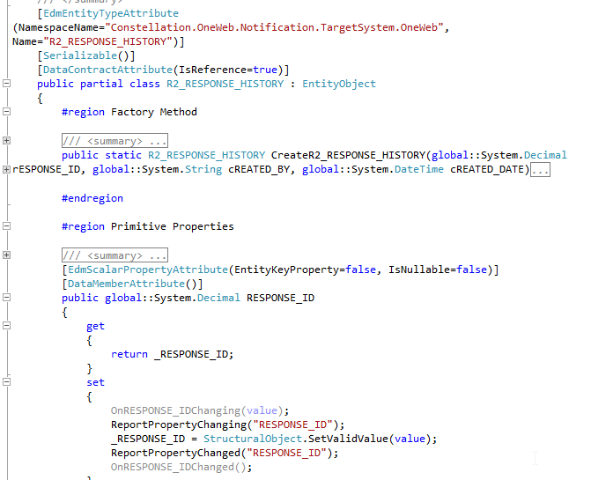
Mapping – EF Database-First

Slide 10
Pre-ORM
Call stored procedure or direct SQL, receive data in rows
Loop through the rows, manually populate objects using the data in each row
Nothing wrong
Just tedious and easy to become inconsistent (same type of object populated by different stored-procedures)

Slide 11
Before ORM
ResiOnlineService
Data Manager
Application
2
6
Residential Data
3
5
SMB API DLL
7
Stored Procedure
O-R Mapping
4
1
8

Slide 12
ORM
Object Oriented Development
We have objects in our system
Objects are normally graph
Creating of Objects

Slide 13
ORM
ORM is NOT the only way
Stored Procedure Mapping
Table Data Gateway
Row Data Gateway
Active Record
Or, why Relational Database? NoSQL

Slide 14
NHibernate
Ported from Java Hibernate
Latest Version: 3.3 (as of April 2013)
Mapping Objects to Relations
Implemented Architectural Ideas of ORM
Quasi-standard of ORM

Slide 15
Entity Framework
Me too product
Had very ambitious goals
Failed to deliver even the same features of NHibernate
Yet, still capture a lot of developer base
However, it’s been gradually improved

Slide 16
ORM Architecture Ideas
Object Mapping
Enum Mapping
Embedded Value
LOB Serialization
Identity Managemet
Identity Field
Identity Mapping
Unit of Work
Lazy/Eager Load
Inheritance Mapping
Repository

Slide 17
NHibernate – Architecture Idea
Configuration
ISessionFactory
ISession
lightweight

Slide 18
EF – Architecture Ideas
ObjectContext
Holds configuration/model
Acts like UnitOfWork
DBContext: Wrapper of ObjectContext
Provides easier API to ObjectContext
Enables Code First approach

Slide 19
POCO Support
Do you need POCO?
A lot of projects are still database-centric → use Data objects directly
Some projects use OO extensively → use POCO to ensure the object model does NOT get influenced by relational model
Truth: most projects using Entity Framework because they are database-centric

Slide 20
Mapping
Allow mapping relations to objects
How?
Format
XML file
Attribute
Code
Autogen
Generate Code from DB
Generate DB from Code

Slide 21
How has it been done?
Manual Mapping
var proc = "OLN.PKG_Residential_LookUps.SP2_GetResponseData";
ResponseData data = new ResponseData(); // object to be filled
... // get data
ds = oda.GetDataSet(dbInfo);
data.BillTypeCode = (ds.Tables[0].Rows[0]["Bill_TYPE_CODE"]);
data.PromoPlanID = (ds.Tables[0].Rows[0]["promo_plan_id"]);
...
return data;

Slide 22
Entity Framework – M4
Entity Framework Mapping
M4 Application
Entity Framework
2
1
3

Slide 23
Entity Framework – Notification

Slide 24
Micro-ORM
I don’t need all the features, just retrieve data, map it to an object, and return the object to me ...
Micro-ORM
Massive
Dapper (StackOverflow)
Notes:
http://www.mindscapehq.com/blog/index.php/2011/12/05/5-reasons-not-to-use-a-micro-orm/
http://www.slideshare.net/kievaltnet/microorm-introduction-dont-overcomplicate

Slide 25
T4 Template
For generating C# code based on the mapping (EDM)

Slide 26
Why Objects?

